Slide 1
Floating Point Representation
By
M. BABY ANUSHA,
ASST.PROF IN CSE DEPT.,
RGUKT,NUZVID

Slide 2
Floating Point Representation
The structure of a floating point(real) number is as follows:
4.2 * 10⁸
Exponent
Mantissa
Base
Only the mantissa and the exponent are stored. The base is implied (known already) As it is not stored this will save memory capacity

Slide 3
IEEE standard
There is a IEEE standard that defines the structure of a floating point number
IEEE Standard for Floating-Point Arithmetic (IEEE 754-2008)
It defines 4 main sizes of floating point numbers 16, 32, 64 and 128 bit
Sometimes referred to as Half, Single, Double and Quadruple precision

Slide 4
A 32 bit floating point number
Sign | Exponent | Mantissa
1bit | 8 bits | 23 bits
S is a sign bit
0 = positive
1 = negative
23 bits for the mantissa
8 bits for the exponent

Slide 5
Lets look at an example
We want the format of a number to be in
m x b^{e}
We want the mantissa to be a single decimal digit
Example
3450.00 = 3.45 x 10³
The exponent is 3 as the decimal place has been moved 3 places to the left

Slide 6
Decimal fractions
First we will look at how a decimal number is made up: 173.75
Hundreds | Tens | Units | Decimal place | Tenth s | Hundredths
1 | 7 | 3 | . | 7 | 5
10² | 10¹ | 10⁰ | Decimal place | ₁₀-1 | ₁₀-2
1 | 7 | 3 | . | 7 | 5

Slide 7
Binary fractions
Then look at how the same number could be stored in binary: 1010 1101
128 | 64 | 32 | 16 | 8 | 4 | 2 | 1 | . | 0.5 | 0.25
1 | 0 | 1 | 0 | 1 | 1 | 0 | 1 |  | 1 | 1
This number is constructed as shown above (in a fixed point notation).
These values come from
₂7 | ₂6 | ₂5 | ₂4 | ₂3 | ₂2 | ₂1 | ₂0 | . | ₂-1 | ₂-2
1 | 0 | 1 | 0 | 1 | 1 | 0 | 1 |  | 1 | 1

Slide 8
A worked example
In decimal first
250.03125
First convert the integer part of the mantissa into binary (as you have done previously)
250 = 1111 1010
Now to convert the decimal portion of the mantissa
.03125

Slide 9
Example (cont)
Decimal fraction => .03125
Multiply and use any remainder over 1 as a carry forward. Continue until you reach 1.0 with no carry over
0.03125 * 2 =
0.0625 * 2 =
0.125 * 2 = 0.25 * 2 = 0.5 * 2 =
0 r 0.0625
0 r 0.125
0 r 0.25
0 r 0.5
1 r 0
Read top to bottom
Binary fraction = 0.00001

Slide 10
So far
So far we have : 1111 1010.00001 (250.03125)
But we need it in the format : .11111 0100 0001 (the decimal point to the left of the 1)
1 | 1 | 1 | 1 | 1 | 0 | 1 | 0 | . | 0 | 0 | 0 | 0 | 1
8 places to the left
. | 1 | 1 | 1 | 1 | 1 | 0 | 1 | 0 | 0 | 0 | 0 | 0 | 1
So the exponent is 8 (1000)

Slide 11

Example
In 32 bit representation there is
8 bits for the exponent
23 bits for the mantissa
We will pad the left of the exponent with 0’s up to 8 bits
We will pad the right of the mantissa
with 0’s up to 23 bits
So back to our example
Mantissa =.11111 0100 0001 (2.5003125)
Exponent = 0000 1000 (8)
Sign Bit = 0
And the number is positive so the sign bit is 0
S | Exponent | Mantissa
0 | 0000 1000 | 11111 0100 000100000000000
1bit | 8 bits | 23 bits

Slide 12
Further Example 1
102.9375
Sign = 0 (+ve) Integer = 102 = 1100110
Decimal portion = .1111 -> Number = 1100110.1111 -> Needs to be .11001101111
Exponent = 7 = 00000111
Number (32 bit Single Precision) = 0 00000111 11001101111000000000000

Slide 13
Further Example 2
250.75
Sign = 0 (+ve) Integer = 250 = 11111010
Decimal portion = .11 -> Number = 11111010.11 -> Needs to be .1111101011
Exponent = 8 = 00001000
Number (32 bit Single Precision) = 0 00001000 11111010110000000000000

Slide 14
What about small numbers?
What if we are storing 0.0625?
The decimal point doesn’t need moved to the left it needs moved to the right…

Slide 15
Example (cont)
Decimal fraction => .0625
Multiply and use any remainder over 1 as a carry forward. Continue until you reach 1.0 with no carry over
0.0625 * 2 =
0.125 * 2 = 0.25 * 2 = 0.5 * 2 =
0 r 0.125
0 r 0.25
0 r 0.5
1 r 0.0
Read top to bottom
Binary fraction = 0.001

Slide 16
So far
So far we have : 0.001 (0.0625)
But we need it in the format .10000000000000000000000
(leading bit after the . has to be a 1)
0 | 0 | 0 | 0 | 0 | 0 | 0 | 0 | . | 0 | 0 | 1 | 0 | 0
2 places to the left
0 | 0 | 0 | 0 | 0 | 0 | 0 | 0 | 0 | 0 | . | 1 | 0 | 0
So the exponent is -2

Slide 17

Example
So back to our example
Mantissa =0.1 (0.0625)
Exponent = 1111 1110 (-2)
Sign Bit = 0
In 32 bit representation there is 23 bits
for the mantissa
We will pad the right of the number with 0’s up to 23 bits
And the number is positive so the sign bit is 0
S | Exponent | Mantissa
0 | 1111 1110 | 10000 0000 000000000000000
1bit | 8 bits | 23 bits

Slide 18
If the Exponent is negative
In reality there are other ways that this is dealt with (offset exponents for those that are interested)
But for the purpose of the course we will store a negative exponent in 8 bit two’s complement:
2 | = | 0000 0010
-2 | = | 1111 1110

Slide 19
What about really small numbers?
What if we are storing 0.0009765625?
The integer portion is 0
The decimal portion is: .0000000001
So our number need to be 0.1
We need to shift the exponent 10 places to the right
This means we need to store -10 as the exponent (two's complement)

Slide 20
Further Example 3
0.0009765625?
Sign = 0 (+ve) Integer = 0 = 0000000
Decimal portion = .0000000001 -> Number = 0.0000000001 -> Needs to be .1
Exponent = -10 = (+10 = 0000 1010) -10 = 1111 0110
Number (32 bit Single Precision) = 0 1111 0110 01000000000000000000000

Slide 21
Different Precision Numbers
Single Precision (32 bit)
S | Exponent | Mantissa
1bit | 8 bits | 23 bits
1.18 × 10^{–38} to 3.40 × 10³⁸
Double precision (64 bit)
S | Exponent | Mantissa
1bit | 11 bits | 52 bits
2.23 × 10^{–308} to 1.79 × 10³⁰⁸

Slide 22
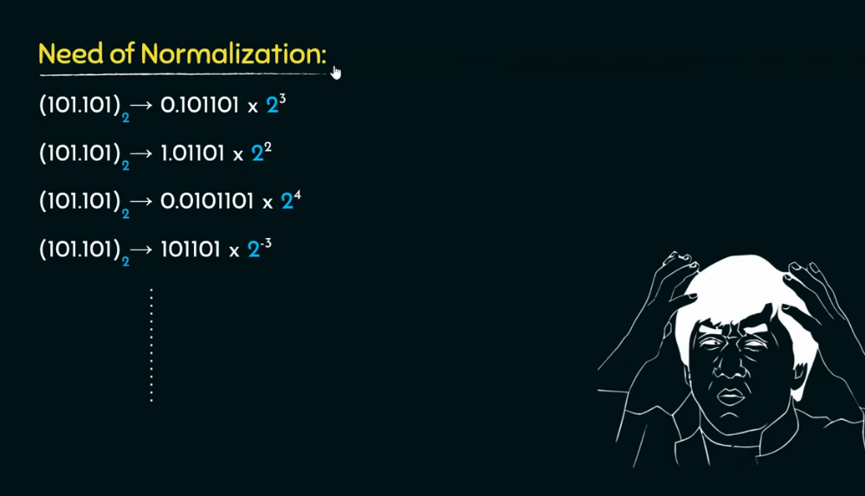

Slide 23
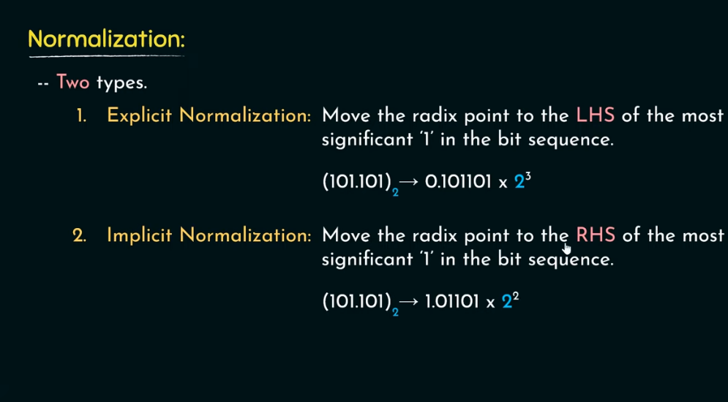

Slide 24


